Slide 1

P3: Update seqex3.py
Presented by Sritama Banerjee
Master’s in Plant Science Dept.
2nd Semester
Introducing a Python script to extract specific regions from biological sequences efficiently.

Slide 2
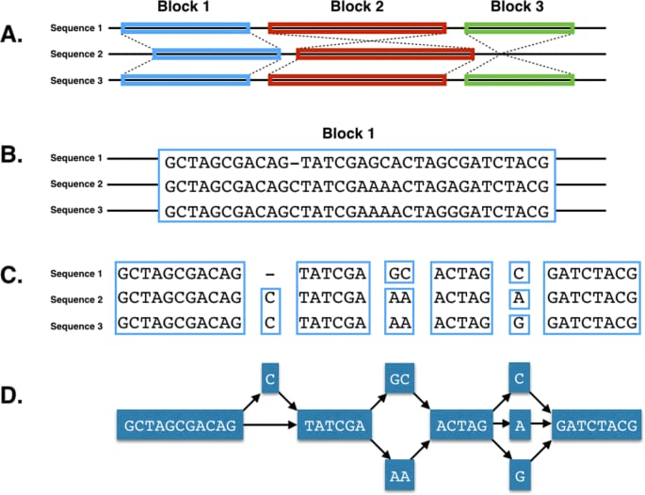
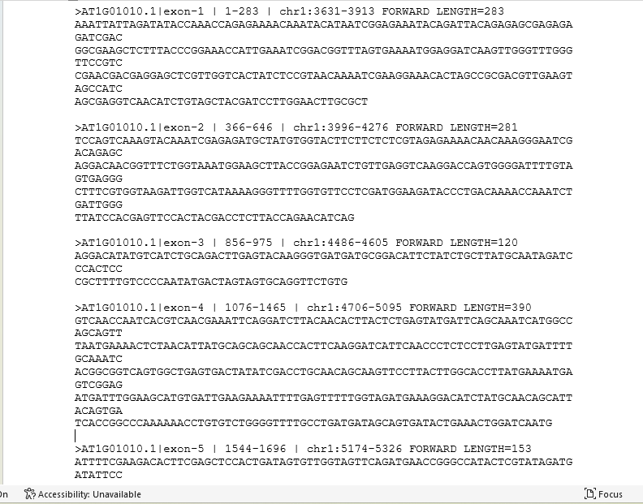
Background
FASTA file – A Text-based format
Stores DNA, RNA, or protein sequences.
Each sequence starts with –
header line beginning with ‘>’(e.g., >gene1)
With following lines contain the sequence itself (A, T, G, C for DNA).
Key Point: A tool in genomics and bioinformatics

Slide 3
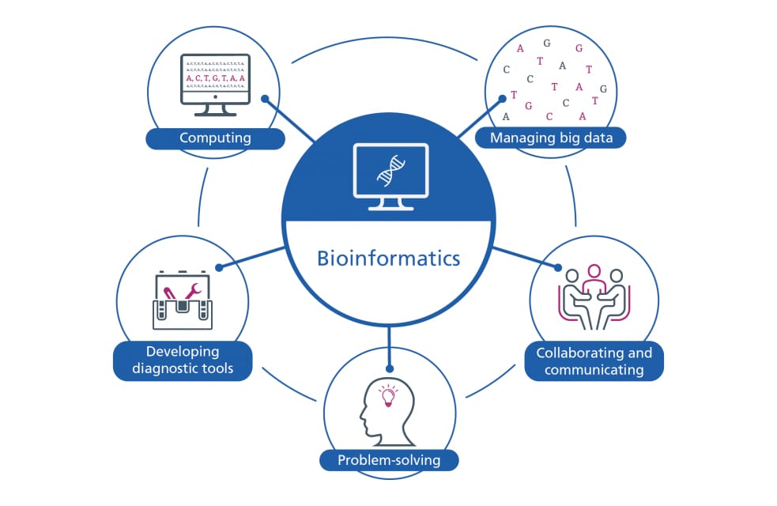
Seqex is short for "sequence extractor“.
For scripts or tools like seqex3.py
Extract specific regions from biological sequences (usually DNA or RNA) stored in FASTA files.
Why is it used in bioinformatics?
Extract genes, exons, or regulatory elements
Add flanking regions - primer design or CRISPR targeting
Handle batch extractions across a genome

Slide 4
Original seqex3.py Limitations
Only one region at a time (manual input).
Inefficient for large datasets.
No built-in support - batch extraction.
Lacked error handling
Objective
Extract a specified target region from a given FASTA file
An update is needed to supply numerous target regions through a text file table
Read table and extract all specified regions and the code is import re

Slide 5
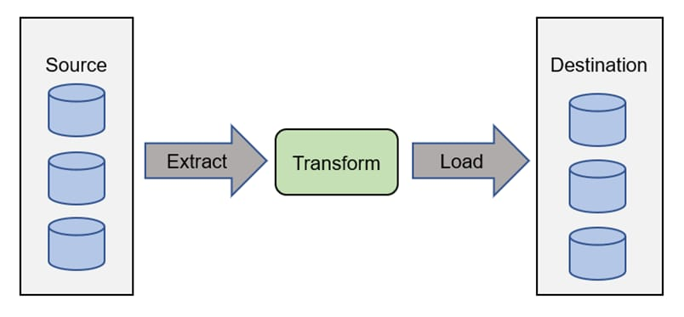
Code Workflow Diagram
FASTA File + Region Table
↓
load_multiple_fasta_file
↓
collect_sequence_regions
├─ Flank left/right
├─ Optional reverse complement
↓
FASTA Output

Slide 6
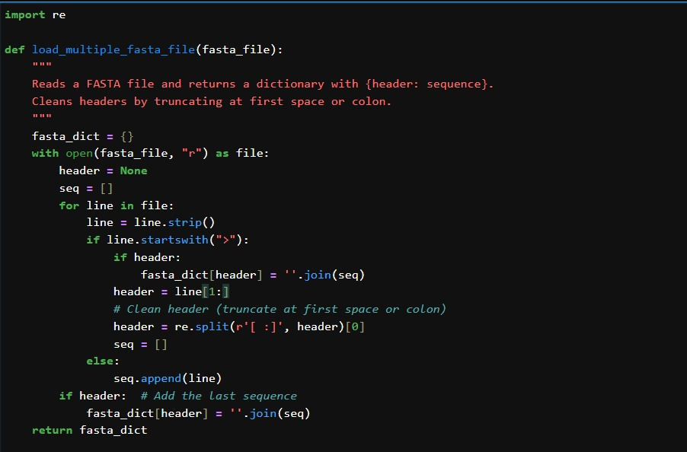
Core Functions Explained
load_multiple_fasta_file: Parses FASTA, returns {header: sequence}
get_sequence_region: Slices a subsequence from a contig
reverse_complement: Converts DNA to reverse complement
collect_sequence_regions: Combines flanks + core, handles flags
write_fasta: Outputs formatted FASTA
input_regions_manually: Manual input (legacy)

Slide 7
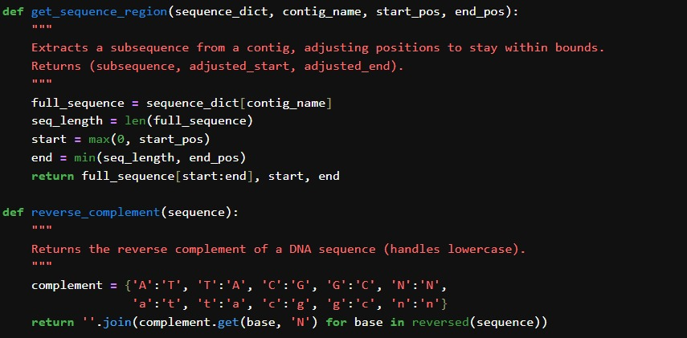
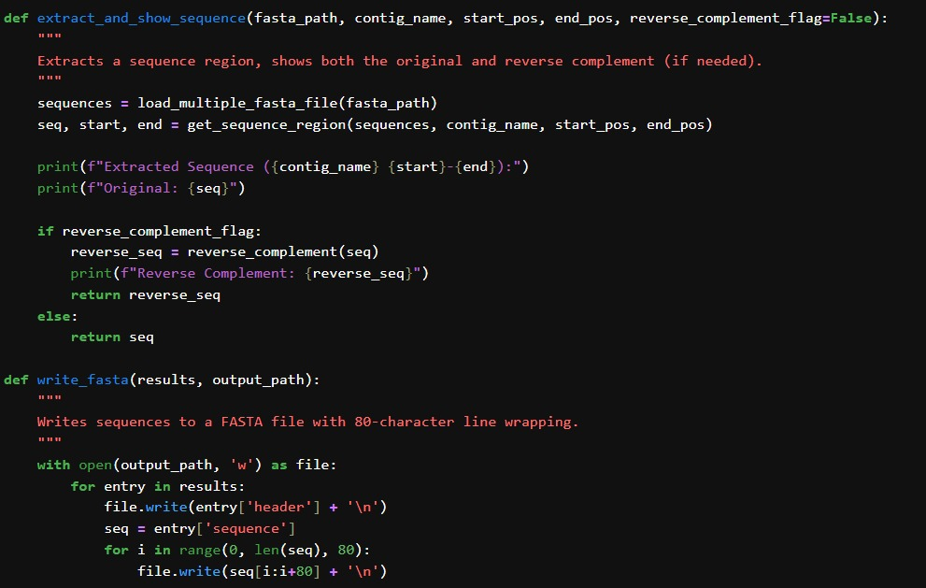
SCRIPT LOGIC

Slide 8
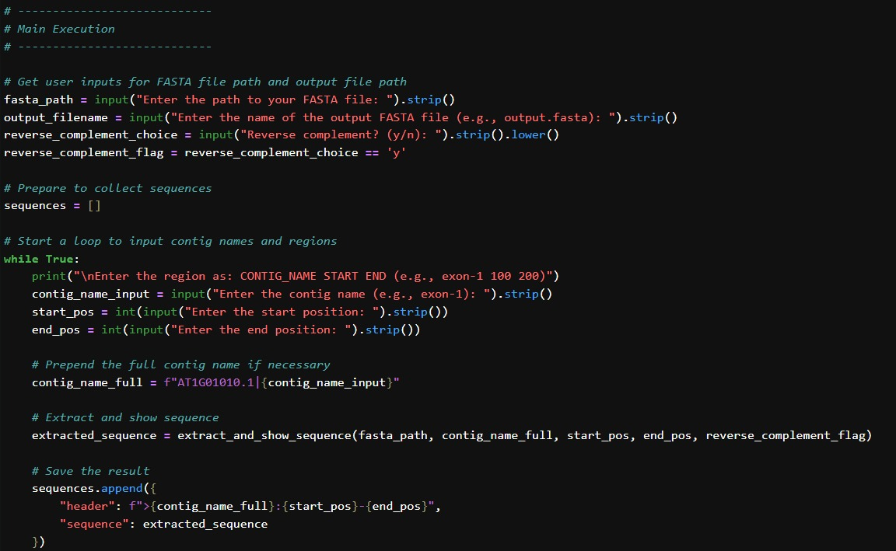
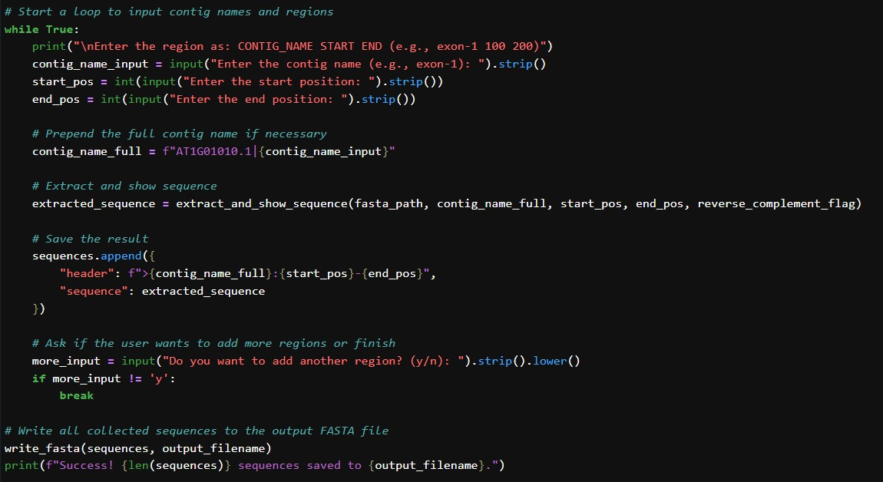
Updated Features
- Read multiple regions from text file
- Add flanking regions (±500 bp)
- Optional reverse complement
- Clean header parsing
- Error handling

Slide 9
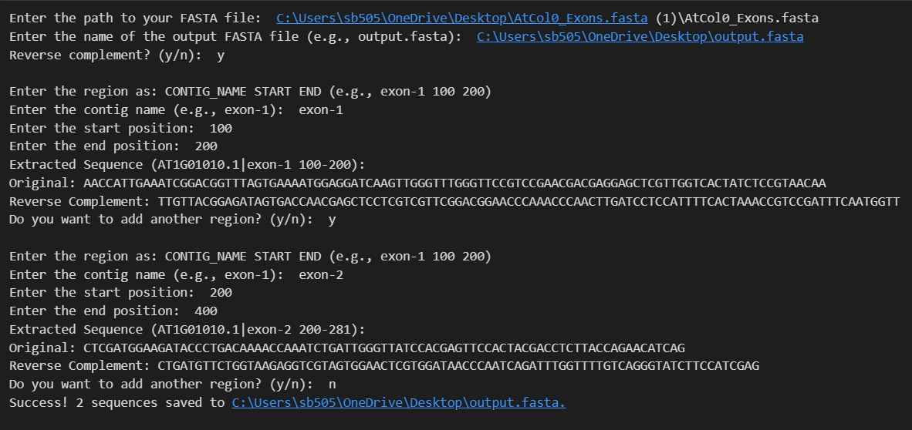
Input Format (Text Table)
Example regions.txt:
contig_name start end
chr1 1000 1200
chr2 2500 2700
Parsed line-by-line or with pandas.
REVERSE COMPLEMENT

Slide 10
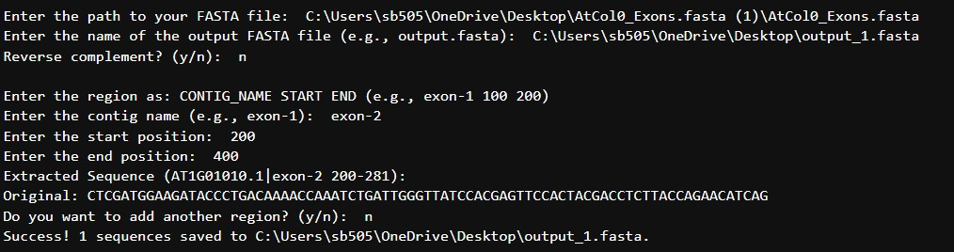
Sample Output
>chr1:500-1700
ggggctac...ACGTTAGC...ccgatttg
Lowercase: flanks
Uppercase: target region
80-character wrapped
WITHOUT REVERSE COMPLEMENT

Slide 11
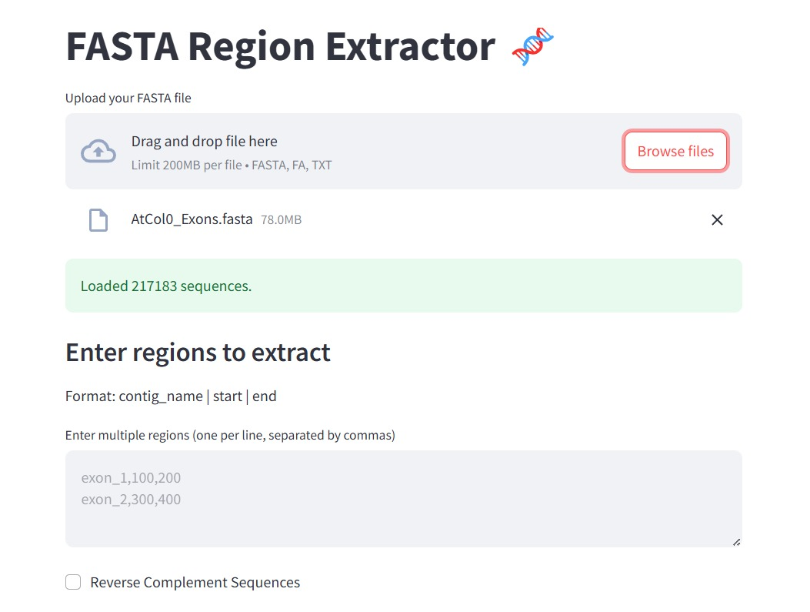
Future Scope
CSV/TSV file support with pandas
GUI (e.g., Streamlit)
BED file compatibility
Batch multiprocessing
Unit tests and benchmarking

Slide 12

Thank you for listening!
GitHub repo link: [https://github.com/sri0402suojee/seqex3.git]
Try it with your own sequences!
Ready to answer your questions.

